Slide 1
IS 120
JavaScript Objects, JSON, and Storage

Slide 2
Announcements
Added an extra HW
Points for Dev Tool Demo have been reduced
Project 3 is due April 16th
Final Project is due April 22nd

Slide 3
HW 10
Why is it important that your cards are generated dynamically based on the array instead of hardcoded in HTML?

Slide 4
Todo List Code

Slide 5
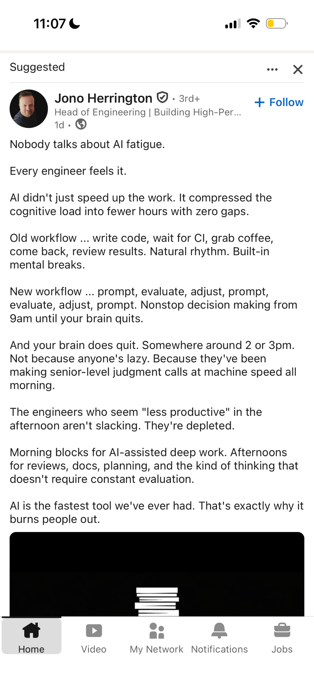
LinkedIn Wisdom

Slide 6
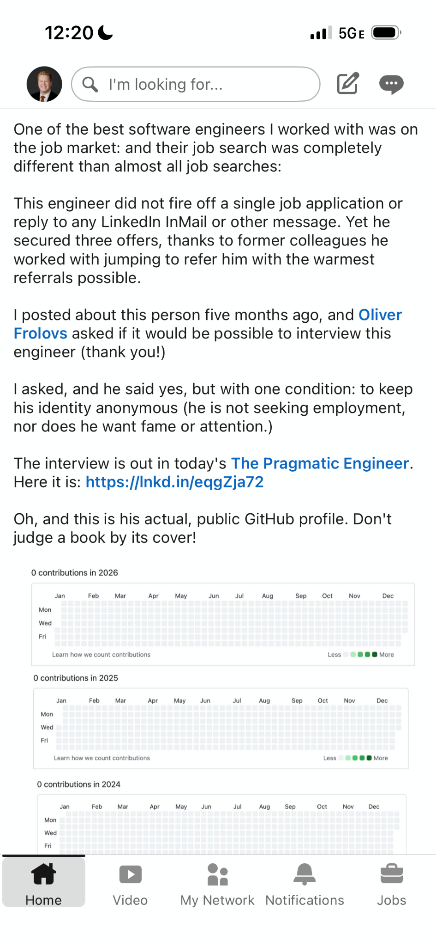
LinkedIn Wisdom

Slide 7
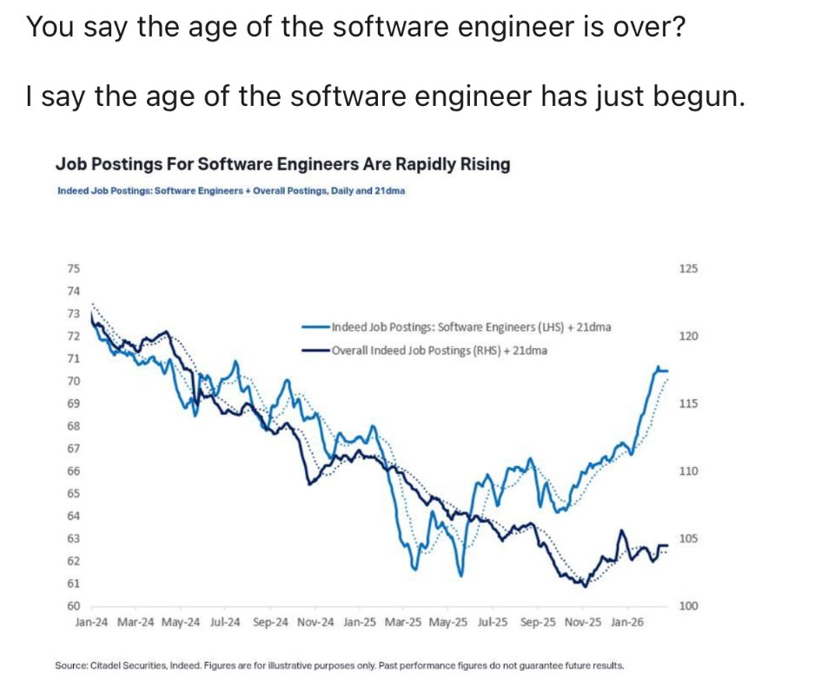
LinkedIn Wisdom

Slide 8
Future Class Topics
https://app.sli.do/event/cFeLpwmdWFLLTW9EdJcX2e

Slide 9
Objects
An object is a collection of data stored using key value pairs
Also referred to as a dictionary
let person = {
name: “Bob”,
age: 35,
isStudent: true
}

Slide 10
Objects
Object values are accessed by their keys
Keys can be used with dot or bracket notation
person.name
person[“name”]

Slide 11
Objects
Object values are accessed by their keys
Keys can be used with dot or bracket notation
person.name <- does this look familiar?
person[“name”]

Slide 12
Objects vs Arrays
What is the use case for each of these?

Slide 13
JSON
JavaScript Object Notation (JSON)
Formatted text used to represent data
Can be easily transformed to a JavaScript Object

Slide 14
JSON
{
“name": "Sarah",
"age": 28,
"isStudent": true
}

Slide 15
JS Object
const person = {
name: "Sarah",
age: 28,
isStudent: true
}

Slide 16
JSON Example
https://api.github.com/users/tmanatkin

Slide 17
JSON Activity
Build a JSON file that represents a single student
Use objects and arrays inside of other data structures to make this as organized as possible
Include name, classes, grades, contact info, etc.

Slide 18
JSON Validator
https://jsonlint.com/

Slide 19
JSON Rules
Top level must be an object or an array
  {} or []
JSON only uses double quotes “ ”
JSON doesn’t allow comments

Slide 20
JSON
JSON.stringify() <- turns a JS object into a JSON string
JSON.parse() <- turns a JSON string back into a JS object

Slide 21
Parse JSON together

Slide 22
Storage
JavaScript allows you to access two types of storage in the browser
localStorage -> Permanent until manually cleared
sessionStorage -> Clears when a page is closed
JavaScript variables -> Clears when a page is refreshed

Slide 23
Storage
The browser allows storage using key value pairs
localStorage.setItem("key", value) -> save
localStorage.getItem("key") -> read
localStorage.removeItem("key") -> delete

Slide 24
Pair programming
Revisit Todo list

